Slide 1

Becoming a CPA:
Your steps to success.
Name, Title, Company

Slide 2


This is the new
Data Analytics
Data Visualization
Technology
accounting.
CPA
Cybersecurity
Robotic Process Automation
Forensics
Notes:
As an accounting major, what you see here won’t come as a surprise to you. By now you understand the role technology and data play in the accounting profession, and you have heard how accounts play a pivotal role in fields such as Cybersecurity, Forensics and Robotic Process Automation.

Slide 3
What is a CPA?
Notes:
You also probably know what a CPA is and have wondered if this is something you would like to pursue.

Slide 4


Certified Public Accountant
Trusted financial adviser
More than a number cruncher
CPAs become CFOs, COOs and CEOs
Proof you know accounting
More respect and money
Notes:
Did you know? A 10% increase job growth for accountants and auditors is projected through 2026.
*Source: U.S. Bureau of Labor Statistics

Slide 5
Why CPA?
Notes:
We’re going to take this discussion a step further and address what it takes to become a CPA, and the benefits of doing so.

Slide 6

San Francisco Senior Manager - $293,288 Manager - $173,475 Associate - $97,875
Chicago Senior Manager - $265,045 Manager - $156,770 Associate - $88,450
NYC Senior Manager - $296,546 Manager - $175,403 Associate - $98,963
Source: Robert Half 2025 Salary Guide – Audit/Assurance Services – Public Accounting 75th percentile
Notes:
First, let’s talk salary. It pays to become a CPA. The salaries referenced here are from the Robert Half Salary Guide – Audit/Assurance Services in Public Accounting, and represent the 75th percentile. Stay the course and make Partner, and start around $400K+ per year.

Slide 7

New Partners can make $400K+
Notes:
To become an Audit Partner at a CPA Firm; you’ll need a CPA License

Slide 8
Benefits of CPA Licensure
Prestige and respect
Competitive edge
Career security
Job satisfaction and variety
Income potential
Respected and admired by their peers, clients and society, CPAs are often viewed as an elite group of professionals.
Earning a CPA license demonstrates a commitment to the profession and often highlights potential candidates for leadership and management positions.
Due to a shortage of experienced accounting professionals in business today, CPAs are in more demand than ever before.
CPAs have a plethora of career paths to choose from and have above-average flexibility and upward mobility.*
For new college graduates, a CPA license can mean a difference of 10% between them and their non-licensed peers.
*Source: U.S. News Career Rankings, Best Business Jobs, http://money.usnews.com/careers/best-jobs/accountant
Notes:
There are many benefits to getting a CPA license.
Prestige & respect
Because they have to go through the rigor of sitting for the exam and abide by a set of ethics that other accountants aren’t held to, CPAs are widely respected.
Competitive edge
- Getting a CPA license shows you’re committed to the profession, which gives you an advantage to moving into leadership roles in an organization.
Career security
- CPAs are always in demand, so there’s never a lack of jobs.
Job satisfaction and variety
- CPAs have a plethora of career paths to choose from, and have above-average flexibility and upward mobility.*
Income potential
- As I mentioned earlier, on average, CPAs make 10-15% more than non-CPA accountants.

Slide 9
Benefits of CPA Licensure
Prestige and respect
Competitive edge
Career security
Job satisfaction and variety
Income potential
Respected and admired by their peers, clients and society, CPAs are often viewed as an elite group of professionals.
Earning a CPA license demonstrates a commitment to the profession and often highlights potential candidates for leadership and management positions.
Due to a shortage of experienced accounting professionals in business today, CPAs are in more demand than ever before.
CPAs have a plethora of career paths to choose from and have above-average flexibility and upward mobility.*
For new college graduates, a CPA license can mean a difference of 10% between them and their non-licensed peers.
*Source: U.S. News Career Rankings, Best Business Jobs, http://money.usnews.com/careers/best-jobs/accountant
Notes:
There are many benefits to getting a CPA license.
Prestige & respect
Because they have to go through the rigor of sitting for the exam and abide by a set of ethics that other accountants aren’t held to, CPAs are widely respected.
Competitive edge
- Getting a CPA license shows you’re committed to the profession, which gives you an advantage to moving into leadership roles in an organization.
Career security
- CPAs are always in demand, so there’s never a lack of jobs.
Job satisfaction and variety
- CPAs have a plethora of career paths to choose from, and have above-average flexibility and upward mobility.*
Income potential
- As I mentioned earlier, on average, CPAs make 10-15% more than non-CPA accountants.

Slide 10
Benefits of CPA Licensure
Prestige and respect
Competitive edge
Career security
Job satisfaction and variety
Income potential
Respected and admired by their peers, clients and society, CPAs are often viewed as an elite group of professionals.
Earning a CPA license demonstrates a commitment to the profession and often highlights potential candidates for leadership and management positions.
Due to a shortage of experienced accounting professionals in business today, CPAs are in more demand than ever before.
CPAs have a plethora of career paths to choose from and have above-average flexibility and upward mobility.*
For new college graduates, a CPA license can mean a difference of 10% between them and their non-licensed peers.
*Source: U.S. News Career Rankings, Best Business Jobs, http://money.usnews.com/careers/best-jobs/accountant
Notes:
There are many benefits to getting a CPA license.
Prestige & respect
Because they have to go through the rigor of sitting for the exam and abide by a set of ethics that other accountants aren’t held to, CPAs are widely respected.
Competitive edge
- Getting a CPA license shows you’re committed to the profession, which gives you an advantage to moving into leadership roles in an organization.
Career security
- CPAs are always in demand, so there’s never a lack of jobs.
Job satisfaction and variety
- CPAs have a plethora of career paths to choose from, and have above-average flexibility and upward mobility.*
Income potential
- As I mentioned earlier, on average, CPAs make 10-15% more than non-CPA accountants.

Slide 11
Benefits of CPA Licensure
Prestige and respect
Competitive edge
Career security
Job satisfaction and variety
Income potential
Respected and admired by their peers, clients and society, CPAs are often viewed as an elite group of professionals.
Earning a CPA license demonstrates a commitment to the profession and often highlights potential candidates for leadership and management positions.
Due to a shortage of experienced accounting professionals in business today, CPAs are in more demand than ever before.
CPAs have a plethora of career paths to choose from and have above-average flexibility and upward mobility.*
For new college graduates, a CPA license can mean a difference of 10% between them and their non-licensed peers.
*Source: U.S. News Career Rankings, Best Business Jobs, http://money.usnews.com/careers/best-jobs/accountant
Notes:
There are many benefits to getting a CPA license.
Prestige & respect
Because they have to go through the rigor of sitting for the exam and abide by a set of ethics that other accountants aren’t held to, CPAs are widely respected.
Competitive edge
- Getting a CPA license shows you’re committed to the profession, which gives you an advantage to moving into leadership roles in an organization.
Career security
- CPAs are always in demand, so there’s never a lack of jobs.
Job satisfaction and variety
- CPAs have a plethora of career paths to choose from, and have above-average flexibility and upward mobility.*
Income potential
- As I mentioned earlier, on average, CPAs make 10-15% more than non-CPA accountants.

Slide 12
Benefits of CPA Licensure
Prestige and respect
Competitive edge
Career security
Job satisfaction and variety
Income potential
Respected and admired by their peers, clients and society, CPAs are often viewed as an elite group of professionals.
Earning a CPA license demonstrates a commitment to the profession and often highlights potential candidates for leadership and management positions.
Due to a shortage of experienced accounting professionals in business today, CPAs are in more demand than ever before.
CPAs have a plethora of career paths to choose from and have above-average flexibility and upward mobility.*
For new college graduates, a CPA license can mean a difference of 10% between them and their non-licensed peers.
*Source: U.S. News Career Rankings, Best Business Jobs, http://money.usnews.com/careers/best-jobs/accountant
Notes:
There are many benefits to getting a CPA license.
Prestige & respect
Because they have to go through the rigor of sitting for the exam and abide by a set of ethics that other accountants aren’t held to, CPAs are widely respected.
Competitive edge
- Getting a CPA license shows you’re committed to the profession, which gives you an advantage to moving into leadership roles in an organization.
Career security
- CPAs are always in demand, so there’s never a lack of jobs.
Job satisfaction and variety
- CPAs have a plethora of career paths to choose from, and have above-average flexibility and upward mobility.*
Income potential
- As I mentioned earlier, on average, CPAs make 10-15% more than non-CPA accountants.

Slide 13
Benefits of CPA Licensure
Prestige and respect
Competitive edge
Career security
Job satisfaction and variety
Income potential
Respected and admired by their peers, clients and society, CPAs are often viewed as an elite group of professionals.
Earning a CPA license demonstrates a commitment to the profession and often highlights potential candidates for leadership and management positions.
Due to a shortage of experienced accounting professionals in business today, CPAs are in more demand than ever before.
CPAs have a plethora of career paths to choose from and have above-average flexibility and upward mobility.*
For new college graduates, a CPA license can mean a difference of 10% between them and their non-licensed peers.
*Source: U.S. News Career Rankings, Best Business Jobs, http://money.usnews.com/careers/best-jobs/accountant
Notes:
Overall - Why CPA?
CPAs are in high demand and are in a unique position to help individuals, communities, groups, and companies with their financial, accounting, and business challenges to further the public good by protecting the public interest.
The profession and the role and responsibilities of the CPA are changing, opening new doors. The reality is far from the stereotype of the CPA sitting at a desk all day working alone.
Today’s CPAs are taking on more responsibilities earlier in their careers.
Manual tasks once handled by the newly licensed CPA are becoming automated or outsourced, leaving room for new CPAs to take part in the higher-valued work earlier than in the past – work such as consulting, data analysis or personal financial planning.
Prestige and respect & Competitive edge
Earning the CPA license takes dedication and hard work and elevates and sets a CPA apart from others in the accounting and finance profession.
A CPA is recognized globally not only as someone with specialized accounting expertise, but also for the tenacity and dedication it takes to earn the CPA, traits organizations admire and often look for when hiring or promoting.
A CPA is a trusted advisor to individuals, businesses, and other organizations, helping each achieve their financial dreams and goals.
Whether advising businesses on multi-million-dollar acquisitions, auditing companies’ 401K plans, or helping people invest for retirement, a CPA’s adherence to a strict code of ethics along with accounting and finance expertise allows the public to put their trust in CPAs.
Career security
By completing a Bachelor and/or Master’s degree consisting of at least 150 credits, passing a rigorous, respected CPA Exam, bound by the ethics of licensure, and exuding the skills and traits that it requires to become CPA, the CPA often becomes the most desired candidate for a job opportunity.
Job satisfaction and variety
The CPA license offers career paths into some of today’s hottest, most desirable careers like personal financial planning, data analytics, IT risks, controls and governance, emerging technologies, cybersecurity, financial forensics, auditing of organizations’ Environmental, Social and Governance (ESG) initiatives -- just to name a few.
CPAs with entrepreneurial aspirations frequently start their own businesses. Speaking “the language of business” gives CPAs a major advantage when it comes to business. CPAs can objectively evaluate the business idea, develop a business plan, establish the business structure, and more.

Slide 14
Paths
To CPA Licensure

Slide 15

Three Paths to Becoming a CPA
Master's + 1 Path
Requires a post-baccalaureate degree with an accounting concentration, one year of supervised experience and passage of the CPA Exam.
Bachelor's Plus 30 Credit Hours + 1 Path
Involves a baccalaureate degree with an accounting concentration plus 30 additional credit hours, one year of supervised experience, and passage of the CPA Exam.
NEW! Bachelor’s + 2 Path
A new option requiring a bachelor degree (with an accounting concentration), two years of supervised experience, and passage of the CPA Exam.
Notes:
I wanted to share with you some information around the pathways to becoming a CPA, so that you’re aware and can choose your path appropriately.
I’ll cover at a high level the pathways.
There are now three paths to CPA licensure—each built around education, experience, and the exam.
These changes are meant to address the challenges around the time and cost of education. Each path maintains the quality and trust associated with being a CPA.
The new path adds flexibility: If you’ve completed a bachelor’s degree and gain two years of experience under a CPA, you can still pursue licensure in participating states.
About 20 states have adopted the bachelors path, and others are actively considering it. So it’s important to check your state’s rules.
If you’re unsure which path fits your goals and timeline, the following slides offer some factors to consider within each pathway.

Slide 16
Factors to consider when determining a path
State availability:
Is the new bachelor's + 2 path approved in your jurisdiction?
Learning style:
Do you prefer academic study or applied, on-the-job learning?
Would you prefer sitting for the CPA Exam during school or while working?
Timeline & cost:
Do you want to start earning sooner, or invest in more formal education first that may be a competitive edge for some roles?
Career goals:
Are you targeting firms, industries, or roles that value advanced degrees?
Notes:
First is state availability. Not all states have adopted the bachelor’s pathway, so it’s important to know the licensure requirements in your state. I’ll be sharing a link shortly where you can stay up-to-date.
The next thing to consider would be your learning style. Do you prefer academic study, or more on-the-job learning? And would you prefer sitting for the CPA Exam during school or while working?
Next is timeline and cost. Do you want to start earning sooner or invest in more formal education first that may be a competitive edge for some roles?
Lastly, you’ll want to consider your career goals. Are you targeting firms, industries, or roles that value advanced degrees?

Slide 17
Master’s degree plus one year of supervised experience
Best for:
Students planning to specialize (e.g., tax, audit, data analytics) or pursue academic/research opportunities
Those who enjoy a classroom environment and want deeper academic preparation
Candidates applying to firms or organizations that prefer or require a master’s
Those who want to sit for the CPA Exam while in school
Considerations:
Higher upfront cost and time investment
May provide a competitive edge for certain employers or markets
Having 150 credit hours gives your CPA license the most national flexibility, for now. As more states adopt the bachelor’s +2 path, more flexibility will exist under that route.
Notes:
These next 3 slides offer additional considerations for each of the paths.

Slide 18
Bachelor’s + 30 credits plus one year of supervised experience
Best for:
Students who want flexibility in how they earn the extra credits (grad school, online, electives, etc.)
Candidates looking to enter the workforce while finishing up additional coursework
Those whose state or program structures education around this model
Considerations:
Requires careful planning to ensure credits qualify
Can be completed more affordably than a full master’s, depending on how credits are earned
Many universities offer integrated 4+1 programs (accelerated bachelor’s + master’s)

Slide 19
NEW: Bachelor’s plus two years of supervised experience
Best for:
Students eager to enter the workforce immediately after earning a bachelor’s
Nontraditional students balancing work and education
Those who prefer learning through hands-on experience rather than additional coursework
Considerations:
Not available in all jurisdictions—students must check their state’s requirements
Longer experience timeline (2 years vs. 1 year in other paths)
Candidates should consider any extra time it may take to pass the CPA Exam while working
New licensees may need to take additional steps to practice across state lines (if this path is not recognized in another state)

Slide 20
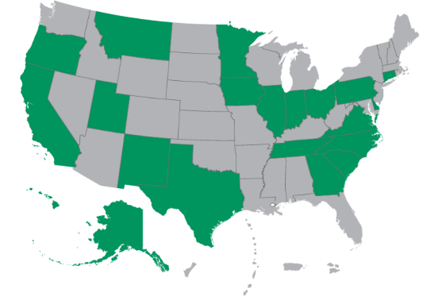

Resources available today
NASBA has launched a page that lists jurisdictions that have already signed new licensure pathways into law, including effective dates and summary information for the new pathway.
Map Is Current as of October 8, 2025
https://nasba.org/blog/2025/07/01/new-licensure-pathways/
Notes:
**NOTE TO PRESENTER** Update this slide with the most recent map found on NASBA’s website.
NASBA is the National Association of State Boards of Accountancy. CPA licenses are issued by the State Boards, so NASBA is your resource to stay up-to-date on which states have signed new licensure pathways into law. This map shows the states that have made updates, but this is frequently changing so I recommend you check back often.

Slide 21


What do you need to become a CPA?
+
+
+
=
Education
Experience
Ethics*
Exam
CPA
* Certain states require a separate ethics assessment in addition to what is tested on the CPA Exam.
Notes:
What does it take to be a CPA? While exact requirements vary by state, essentially all candidates need…
The 4 E’s:
Education
Experience
Ethics (some states do not require this)
Examination (passing 3 core sections and 1 discipline section)

Slide 22
The CPA Exam
Notes:
Since you can’t become a CPA without passing the exam, let’s talk a little more about what you need to be ready to pass.

Slide 23




Who’s who in the CPA Exam process
CPA Exam
State boards are the licensing bodies, and the exam helps them meet their regulatory responsibilities.
Notes:
The AICPA is responsible for the development and scoring of the CPA Exam. We have extensive resources on our website (http://www.thiswaytocpa.com/) and have your back now and throughout your career.
NASBA the association for boards of accountancy, provides additional services on its own and through its subsidiary, CPAES (CPA Examination Services). They are your go-to resource for specific requirements in the 55 U.S. accounting jurisdictions.
Prometric Test Center is responsible for the delivery of the exam to approved test centers, scheduling test appointments, test administration and the return of results to the AICPA for scoring.
State Boards are the licensing bodies; the exam helps them meet their regulatory responsibilities.

Slide 24
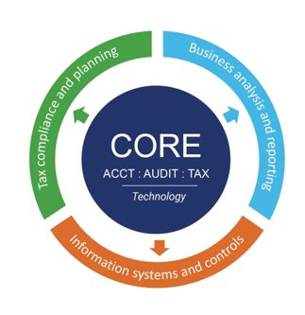
Uniform CPA Exam®
Candidates pass the three Core sections and one Discipline section (max = 4 sections)
Exam sections can be taken in any order
Time limits for passing the CPA Exam depend on your specific jurisdiction. NASBA is the best resource
Candidates don’t have the option to pass additional Disciplines
Discipline passed will not differentiate the license granted
Notes:
Candidates are tested at the 1 – 2-year level.
The Exam is16 hours, and there are no new experience requirements to sit for the Exam.
Candidates are still required to pass a total of 4 exam sections, and those exam sections could be taken in any order.
This means, if I’m taking REG, I could follow that up with the tax discipline before I pass the rest of the core.
There is no separate time limits to pass the core and the discipline – candidates would have one set amount of time to pass.

Slide 25
Which discipline is for me?

Slide 26
Business Analysis and Reporting (BAR)
Assesses knowledge and skills in:
Analyzing financial statements and financial information
Select technical accounting and reporting requirements
Revenue recognition and lease accounting
State and local government accounting and reporting
Notes:
BAR will assess knowledge and skills a newly licensed CPA must demonstrate with respect to analyzing financial statements and financial information (including the use of data); select technical accounting and reporting requirements applicable to for-profit business entities (e.g. stock compensation, business combinations, derivatives) and higher order skills related to revenue recognition and lease accounting, and state and local government accounting and reporting requirements.

Slide 27

Business Analysis and Reporting (BAR)
For candidates interested in:
Financial and business analysis
Financial statement audits
Analytics, technical accounting and financial reporting
Skillsets Required:
Critical Thinking
Relationship Building
Data Analysis
Types of Roles:
CFO
Financial Analyst
Entrepreneur

Slide 28
Information Systems and Controls (ISC)
Assesses knowledge and skills in:
IT audit
Advisory services
SOC engagements
Data management
Notes:
ISC will assess knowledge and skills a newly licensed CPA must demonstrate with respect to IT audit and advisory services, including SOC engagements, data management, including data collection, storage, and usage throughout the data life cycle.

Slide 29

Information Systems and Controls (ISC)
For candidates interested in:
Advisory services
Information systems and IT audit
Cybersecurity
System and Organization Controls (SOC) engagements
Skillsets Required:
Information technology
Critical Thinking
Collaboration
Types of Roles:
IT Auditor
Cybersecurity Specialist
CIO (Chief Information Officer)

Slide 30
Tax Compliance and Planning (TCP)
Assesses knowledge and skills in:
U.S. federal tax compliance
U.S. federal tax planning
Personal financial planning
Notes:
TCP will assess knowledge and skills a newly licensed CPA must demonstrate with respect to U.S. federal tax compliance for individuals and entities with a focus on nonroutine and higher complexity transactions, U.S. federal tax planning for individuals and entities, and personal financial planning.

Slide 31

Tax Compliance and Planning (TCP)
For candidates interested in:
Taxation
Personal financial planning
Skillsets Required:
Organization
Communication
Detail Oriented
Types of Roles:
Tax Accountant
Personal Financial Planner
Small Business Owner
Partner in a Public Accounting Firm

Slide 32
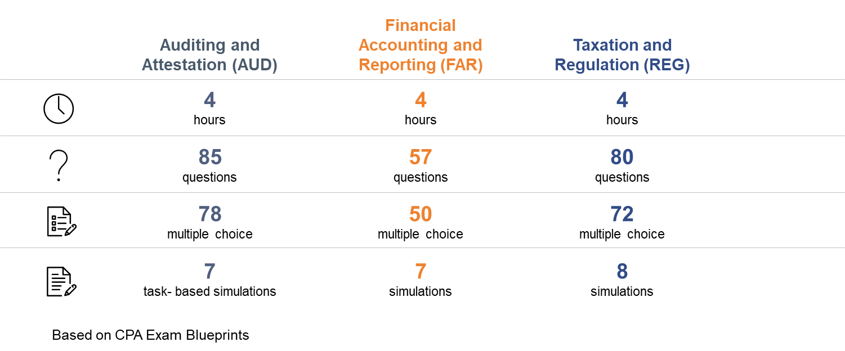
The three Core sections of the Exam

Slide 33
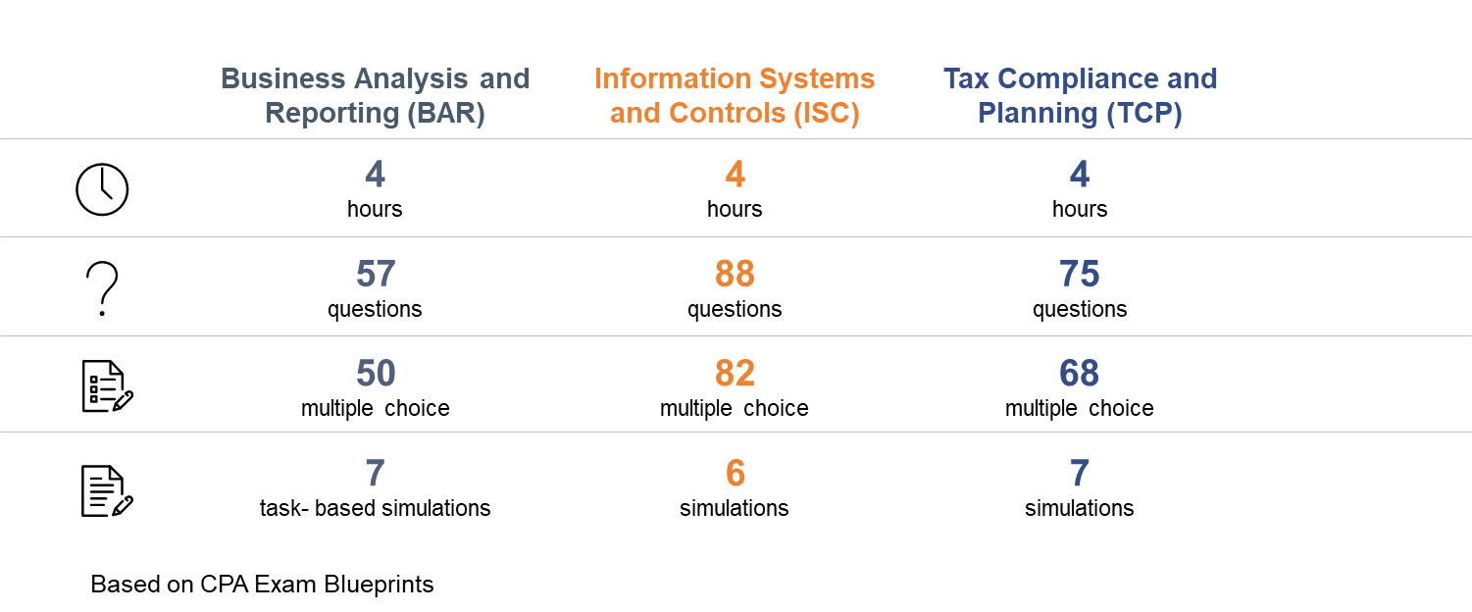
The Discipline sections of the Exam

Slide 34
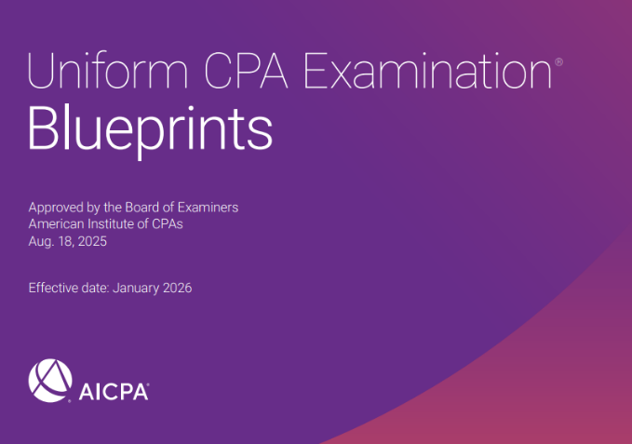




CPA Exam Blueprints: The Operative Document for all CPA Exam Content
Content Organization & Weighting
Skill Allocation
& Weighting
Representative
Tasks
References
Notes:
Introduction – Overall
Sections Introduction – generally what is covered, including content allocation
Overview of what is assessed in each of the Content Areas
Section assumptions, AUD … reminder to focus on entity type and engagement type
Audits of issuer or nonissuer
Reviews
Interim reviews
Compilation engagement
Auditor, accountant or practitioner
Discussion of skills and generally where assessed
Reference materials, e.g., (list is not all inclusive)
AICPA Statements on Auditing Standards
PCAOB Auditing Standards
AICPA Statements of Standards for Accounting and Review Services
AICPA Statements of Standards for Attestation Engagements
AICPA Code of Professional Conduct
Summary blueprint – Content and skill allocations (effectively the next slide)
Detail blueprints – this provides the essence of what can be assessed – Tasks are representative. Skill is the result of the task statement

Slide 35
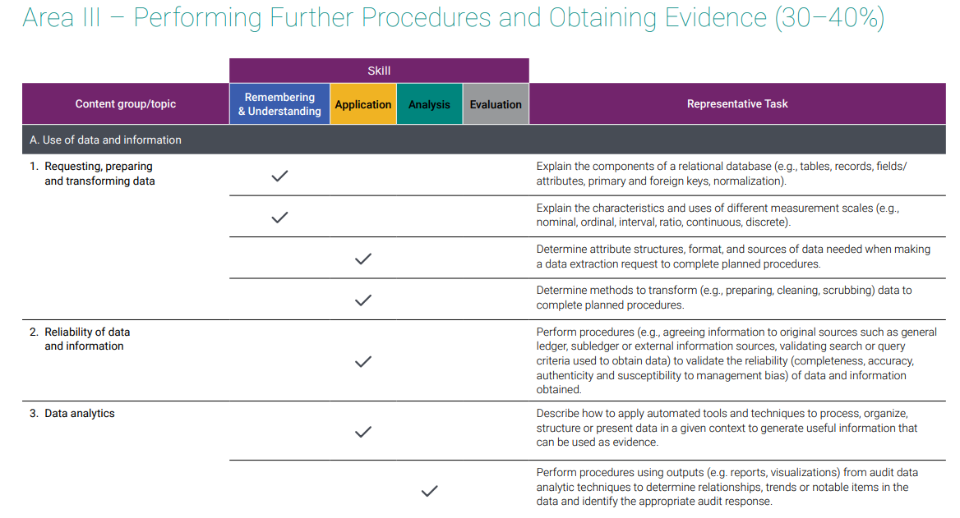
Detail Blueprint Example
Notes:
Actual example of Blueprint document showing the content Area, Group, and Topic; skill level tested; and representative task statement.
The Blueprints are a public document available to all and can be located:
https://www.aicpa.org/resources/download/learn-what-is-tested-on-the-cpa-exam
Or google CPA Exam Blueprints

Slide 36
Resources

Slide 37
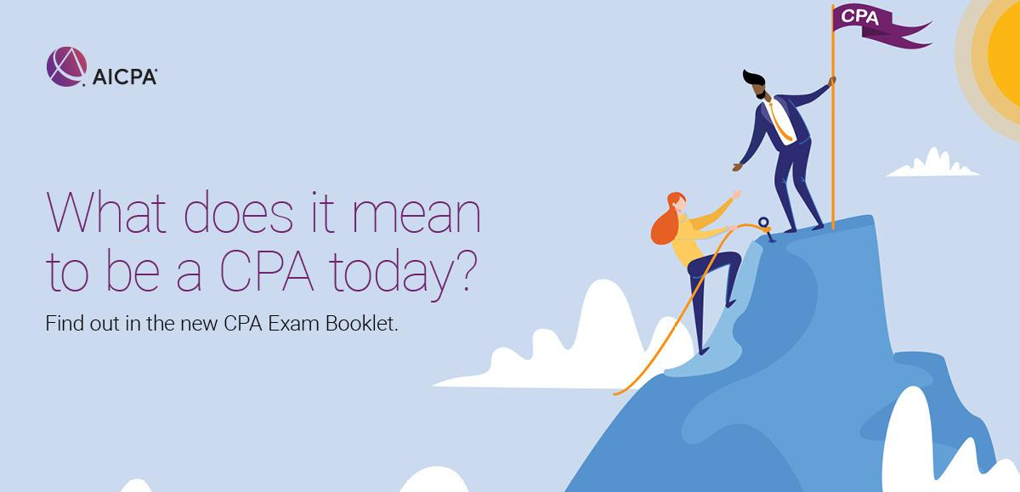

Check out the CPA Exam booklet!
Notes:
The CPA Exam booklet is a great resource that covers everything you need to know about the CPA exam.

Slide 38


Learn what’s tested on The Uniform CPA Examination
Get the latest exam announcements
Learn what is tested by each exam section with the CPA Exam Blueprints
Review sample tests and tutorials
And much more!
Notes:
Additional resources if you’re considering pursuing CPA licensure can be found on our CPA Exam toolkit page. This is a great page to bookmark. Here you can find the latest on the CPA Exam, review sample tests and tutorials, and find a link to the Exam Blueprints.

Slide 39

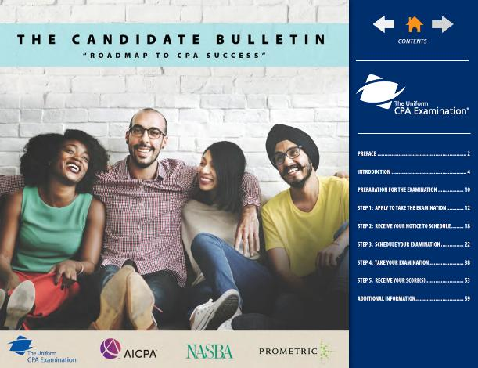
Notes:
Everything you need to know can be found in the Candidate Bulletin.
Exam content
How to schedule your exam
what to expect on test day
how the exam is scored
when you should expect your scores.
Include Qrcode

Slide 40



Notes:
Subscribe to the Next Stop: CPA podcast to hear from professionals in the accounting industry. New episodes dive deeper into the CPA Exam, making this a great resource if you’re on the path to CPA licensure.

Slide 41
What now?

Slide 42
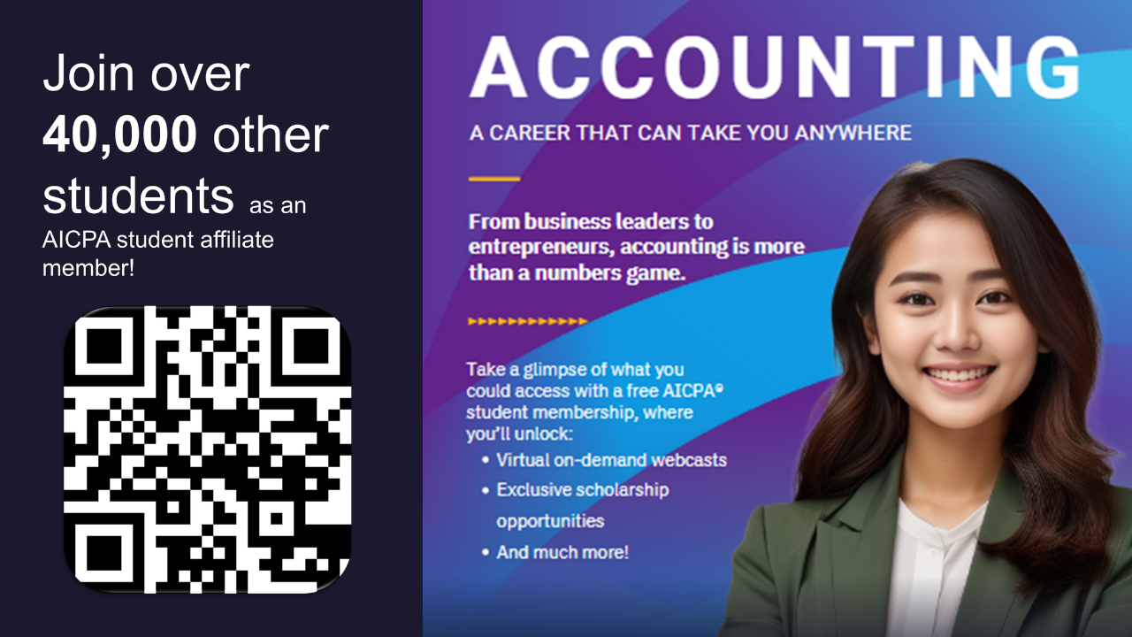
Notes:
First, join the AICPA for FREE as an AICPA student affiliate member. Members receive…
Access to webinars where you can hear from industry professionals.
The opportunity to apply for scholarships that will help you pay for college. The AICPA Foundation awards over $1 Million in scholarship funds each year to students majoring in accounting!
And you can build your LinkedIn profile using templates and professional advice to help you stand out!

Slide 43



CPA Candidate Membership
Eligibility:
A college graduate
You plan to study, are studying, or currently taking the CPA Exam
Member-Only Benefits
01
Exam Resources & Professional Support
02
Get assistance paying for
the Exam
Access CPA Exam Resources and join a network of individuals on a similar path.
The AICPA Foundation awards over $75,000 in scholarship funds to candidates for exam fees & prep courses.
03
Transformative Skills Pack
04
Partner Offers & Discounts
Take advantage of the Digital Mindset Pack, Future Mindset Pack and future skills development.
Members-only savings from favorite companies- Lenovo, Marriott, Mercedes-Benz and enjoy discounts on learning products!
Notes:
Once you’ve graduated, you’re eligible for CPA Candidate Membership. Candidate membership is $115 and offers access to exam resources, a Transformative Skills Pack, and partner offers and discounts. And be sure to apply for a CPA Exam Grant to help you pay for exam fees and prep courses. The grant application window generally runs from June 1 through September 15.

Slide 44









Follow Us:
@aicpastudent
Contact Us:
www.ThisWayToCPA.com
ThisWayToCPA@aicpa.org
Notes:
We are @aicpastudent on social media. That includes Instagram, TikTok, LinkedIn and YouTube. By following us, you’ll receive information on upcoming webinars, scholarship deadlines, and even a little accounting humor.
You can always visit our website for more information, and for any questions reach out to: ThisWayToCPA@aicpa.org

Slide 45
Thank You

