Slide 1
Note for presenters:
This presentation is designed as an aid to help you share your career journey with students.
Please remember to keep the presentation conversational and get to know your audience!
Personalize your presentation by:
  Updating slides 4-7 with your information and fun pictures prior to the presentation.
  Connecting with your state CPA society to update slides 15 and 17.
  Making your time with the students fun by sharing your journey in a way they can understand. Remember these students have little to no experience in accounting.
  Reviewing the Notes section of the slides for presenter tips and opportunities to engage the students.
Notes:
Once you have updated your PowerPoint deck, you can delete this slide.

Slide 2







discover your future
Discover a Career with Endless Possibilities
Notes:
I’m an accountant and I’m here today to talk about accounting. Does anyone know what that means? What comes to mind when you think of ‘accounting’?

Slide 3

ac count ant
noun
a person whose job is to keep, inspect, and analyze financial accounts
“accountants are responsible for their client’s personal and professional information”
Oxford Dictionary Definition
Notes:
The Oxford Dictionary defines an accountant as: a person whose job is to keep, inspect, and analyze financial accounts. I’ll talk more about what that looks like for me in a minute, but first a little bit about myself.

Slide 4





Get to know me
Name:
Notes:
Personalize this slide with pictures of yourself with friends and family, doing things you enjoy. Share things that being a CPA has afforded you the ability to do. Share things you’re involved in that you’re passionate about. Include logos of the companies you're involved with (maybe even the AICPA and your state CPA society).

Slide 5



My Role in Accounting
  Company name
  Job title
  What that means
Notes:
Replace the person icon with a fun picture of yourself! Say something like: Now that you know a little bit about me personally, I’m excited to share more about my job in accounting.

Slide 6

But before this I was in your shoes.
Want to know what I did?
Notes:
*Update this slide with pictures of yourself when you were younger – maybe high school or college.*
Before I got to where I am today, I was in your shoes. <Talk students through your pictures.> Would you like to know my journey?

Slide 7
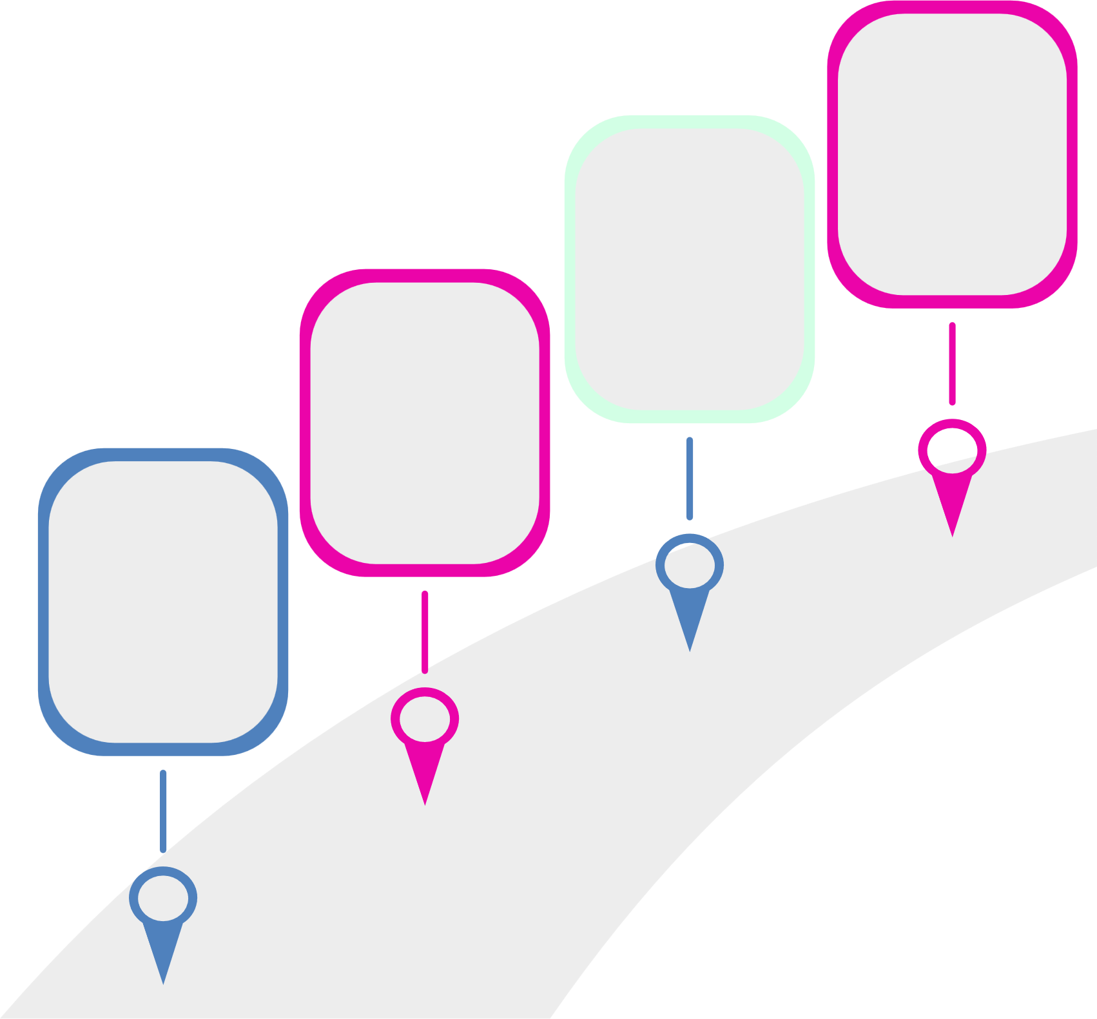

My Journey to Where I am Today Looks Something Like This...
Current
Role
Internship
OR
First Job
College
Reminder to presenters:
Everyone’s journey is unique. Maybe your path wasn’t so straight. Share your journey.
High
School
How long did it take you to get to where you are today?
Did you have an internship?
What was your first job and how did you get it? How quickly did you advance?
Where did you go to school? What was your major?
Did you always know you wanted to go into accounting? What organizations did you join?
What advice to you have?
What classes did you take?
What organizations did you join? What jobs did you have?
Notes:
*Update this slide with information specific to you and your journey. You can use the questions on the slide as ideas to get you started.*

Slide 8

what do accountants do?
Work in any industry
Own your own business
Money Organizers | Problem Solvers
Know how much money a person or business makes or spends on supplies Keep organized records of money spent and earned Ensure records are accurate and easy to understand Determine whether a business is making or losing money | Find and solve money problems Analyze where money is going and identify opportunities for better processes Detect suspicious transactions if money is missing Help individuals and businesses make big financial decisions (like saving for college or buying a new store)
Notes:
Now that we know what an accountant is, and what that looks like for me… what are some other things that accountants do?
Accountants are Money Organizers. Just like you might use a calendar to keep track of homework, or a locker to organize your stuff, accountants organize financial information. They know how much money a person or business makes and spends to ultimately determine whether a business is making or losing money.
Accountants are Problem Solvers. They are like detectives who use numbers to find and fix money-related issues! Like in the event money is missing, they can detect suspicious transactions and look for irregularities. And they help individuals and businesses make big financial decisions, like saving for college or buying a new store.

Slide 9



Now it’s your turn to think like an accountant

Slide 10
Budget Boss
Activity
A fun way to explore accounting and business decisions
Notes:
Set the stage: Have you ever seen Shark Tank or thought about starting your own business? <Pause and wait for a response> Accountants play a big role in whether those business ideas succeed. Today, you’ll get a chance to be entrepreneurs AND accountants.

Slide 11



Instructions
  Work in a small group (3-5 people)
  Your group will receive a Business Idea
  You have $1,000 to spend starting your business
  Decide how to allocate your money in budget categories
  Be ready to give a 30-second pitch of your business & spending choices
Notes:
Explain the challenge: Each group will pick a business idea. You have $1,000 to spend. Your job is to decide how much to put into equipment, marketing, rent, and other expenses. At the end, you’ll give a quick pitch explaining your choices. Emphasize: There’s no perfect answer—just think realistically about what your business would need.

Slide 12
Business Ideas
(or create your own)
Coffee Truck
Sneaker Resale Shop
Pet Grooming Service
Video Game Cafe
Social Media Marketing Agency
Notes:
Ask students to choose a business or come up with a new idea!

Slide 13

Budget Categories
Category | Planned Spending
Equipment/Inventory | $
Marketing/Advertising | $
Rent/Utilities | $
Miscellaneous | $
TOTAL | $
Notes:
During group work, encourage quick decision-making. Walk around, listen in, and ask guiding questions:
“How will people find out about your business?”
“What’s the most important thing to spend on first?”
“Did you leave yourself a cushion for unexpected costs?”
Next, each group gives a 30-second pitch: their business and budget. After each pitch, affirm something smart they did, e.g.:
“Good thinking to spend on marketing—without customers, your business can’t succeed.”
“Smart choice to balance between equipment and advertising—that’s how real businesses think.”

Slide 14
What did you learn? Is there anything you would do differently?
Notes:
Wrap-Up: What you just did is what accountants help businesses do every day. Accounting isn’t just numbers—it’s about helping people make smart decisions and turn ideas into reality. What did you learn from this activity? Is there anything you would do differently?

Slide 15


Want to learn more?
High School
College
Take an accounting class
Take an accounting class
Join a business club or organization (i.e., DECA, BPA, FBLA)
Discuss accounting with a career counselor or
academic advisor
Get involved with your state CPA society!
Discuss accounting with a career counselor
Join an accounting club like Beta Alpha Psi
Ask the adults in your life if they know an accountant
you can shadow for a day
Find an accounting internship or a CPA you can shadow
for a day
Notes:
Are you interested in accounting and want to learn more? Share things they can do now and in college.

Slide 16



Join the AICPA as a free
Student Member
Hear more about different careers
you can have as a CPA.
Apply for scholarships to help
pay for college.
Build your LinkedIn profile with templates and professional advice.
Receive guidance and tips for landing
your first job.
Notes:
Another great way to learn more is to join the AICPA as a free student member. The AICPA & CIMA is the most influential global network of management and public accountants, with nearly 600,000 members worldwide. As a member association, they are here to support you throughout your entire journey, providing membership for high school students, college students, CPA exam candidates and licensed CPAs.
As a student member, you receive access to monthly webinars where you can hear from CPAs in other industries; you can apply for scholarships to help you pay for college - the AICPA Foundation awards over $1M in scholarship funds each year to accounting majors; you receive templates and professional advice to build a LinkedIn profile that will have you standing out; and get help landing your first job with guidance and tips from professionals.

Slide 17
State CPA Society
Information
Personalize this slide with programs available for high school students.
Include resources available for high school students.
Be sure to add websites, or QR codes where available.
And add your state CPA society logo in the frame provided.
Notes:
Connect with your state CPA society for information about high school specific programs and resources in your state!

Slide 18









Follow us:
@AICPAstudent
Contact Us:
www.ThisWayToCPA.com
ThisWayToCPA@aicpa.org
Notes:
Be sure to follow @aicpastudent on social media for information on upcoming webinars, scholarship deadlines, and even a little accounting humor.

Slide 19

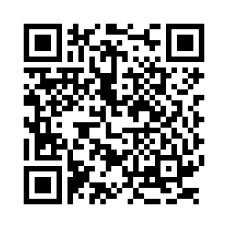

We want to
hear from you!
Notes:
Please first ask the teacher if students are permitted to use their cell phones before asking students to complete the survey.
If not permitted, let the teacher know an email link will be sent to them for students to complete the survey via computer if they’d like.
We’d like to gauge your thoughts on accounting following the presentation and ask that you complete a short survey. The survey is voluntary, only 8 or 9 questions long and will take 1-2 minutes to complete. You just point the camera on your phone to the QR code on the screen and follow the link that comes up.
The following questions are asked:
How did this presentation affect your interest in accounting as a career?
Where do you learn about possible careers?
What is the likelihood that you will pursue accounting as a major?
What is your high school graduation date?
What is the name of the school you are currently attending?
In what City and State is your school located?
What are your plans following high school graduation?
*Optional* If you would like to receive email updates from the AICPA on opportunities in accounting, scholarships, and free student membership, please provide your name and email address.

Slide 20



questions?

