Slide 1
Note for presenters:
This presentation is designed as an aid to help you share your career journey with students.
Please remember to keep the presentation conversational and get to know your audience!
Personalize your presentation by:
  Updating slides 9-12 with your personal information and fun pictures prior to the presentation.
  Connecting with your state CPA society to update slide 18.
  Making your time with the students fun by sharing your journey in a way they can understand. Remember these students have little to no experience in accounting.
  Reviewing the Notes section of the slides for presenter tips and opportunities to engage the students.

Slide 2







discover your future
Discover a Career with Endless Possibilities

Slide 3



Career Aspirations
Dream roles in dream companies
What is your dream job?
Company name:
Job title:
Responsibilities:
Why this is my dream job:
Notes:
Have students think about their dream job: company name, job title, responsibilities, etc. Call on a few to share with the class.

Slide 4



What do these careers have in common?
Notes:
What if I told you that what I do allows me to work with any of those jobs you just mentioned? Can you think of something that all these things have in common?

Slide 5
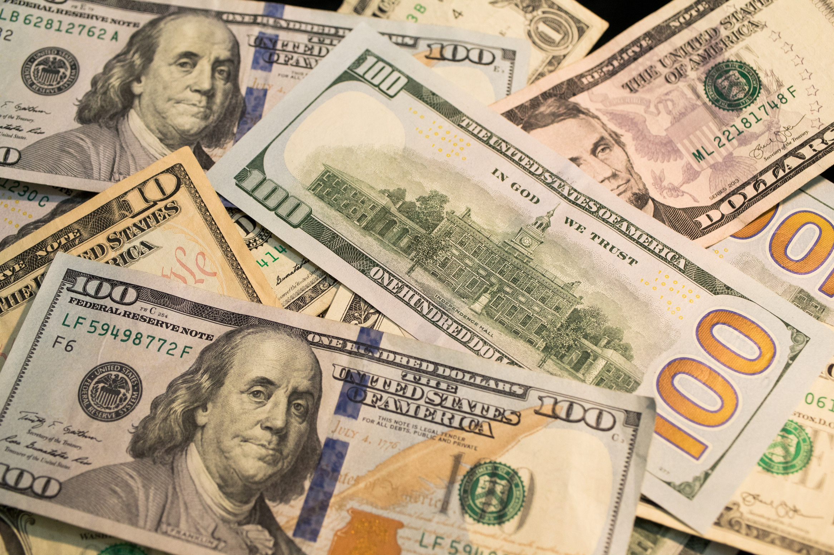

money
+
accountants
Notes:
Money is what all of these have in common, right? And who manages the money? People called Accountants.

Slide 6



What do you do with money?
    Save
    Invest
    Donate
    Spend
Notes:
What do you do when you get money - either from a job, an allowance, or as a gift?
Take this opportunity to connect with the students. Ask for them to share what they do when they get money.
Some of you might save your money, some might want to buy something new. Everyone uses money differently. Many adults and businesses also need help with money. Accountants help manage their money and make sure their business can be successful.

Slide 7

ac count ant
noun
a person whose job is to keep, inspect, and analyze financial accounts
“accountants are responsible for their client’s personal and professional information”
Oxford Dictionary Definition
Notes:
So what is an accountant? The Oxford Dictionary defines an accountant as: a person whose job is to keep, inspect, and analyze financial accounts.

Slide 8

what do accountants do?
Work in any industry
Own your own business
Money Organizers | Problem Solvers
Know how much money a person or business makes or spends on supplies Keep organized records of money spent and earned Ensure records are accurate and easy to understand Determine whether a business is making or losing money | Find and solve money problems Analyze where money is going and identify opportunities for better processes Detect suspicious transactions if money is missing Help individuals and businesses make big financial decisions (like saving for college or buying a new store)
Notes:
Now that we know what an accountant is… what do accountants do?
Accountants are Money Organizers. Just like you might use a calendar to keep track of homework, or a locker to organize your stuff, accountants organize financial information. They know how much money a person or business makes and spends to ultimately determine whether a business is making or losing money.
Accountants are Problem Solvers. They are like detectives who use numbers to find and fix money-related issues! Like in the event money is missing, they can detect suspicious transactions and look for irregularities. And they help individuals and businesses make big financial decisions, like saving for college or buying a new store.
8

Slide 9




What is My Role in Accounting?
  Company name
  Job title
  What that means
Notes:
Replace the person icon with a fun picture of yourself! And now share more about your role in accounting: the name of your company and job title. Share what that means in a way that high school students (with little to no background in accounting) can understand. Relate what you do to current events or tie it back to one of the career aspirations someone mentioned at the beginning of the presentation.

Slide 10




Get to know me
Name:
Notes:
Now that you know what my job in accounting looks like, I want to share a little more about me.
Personalize this slide with pictures of yourself with friends and family, doing things you enjoy.
Share things you’re involved in that you’re passionate about. Include logos of the companies you're involved with (maybe even the AICPA and your state CPA society).
Share things that being a CPA has afforded you the ability to do.

Slide 11
Before I got to where I am today, I was in your shoes.
Want to know what I did?
Notes:
If you can, update this slide with pictures of yourself in high school and/or college and share with students what you were like at that time. What were you interested in? What organizations were you a part of?
Tell the students: Before I got to where I am today, I was in your shoes. Would you like to know what I did to get to where I am today?

Slide 12
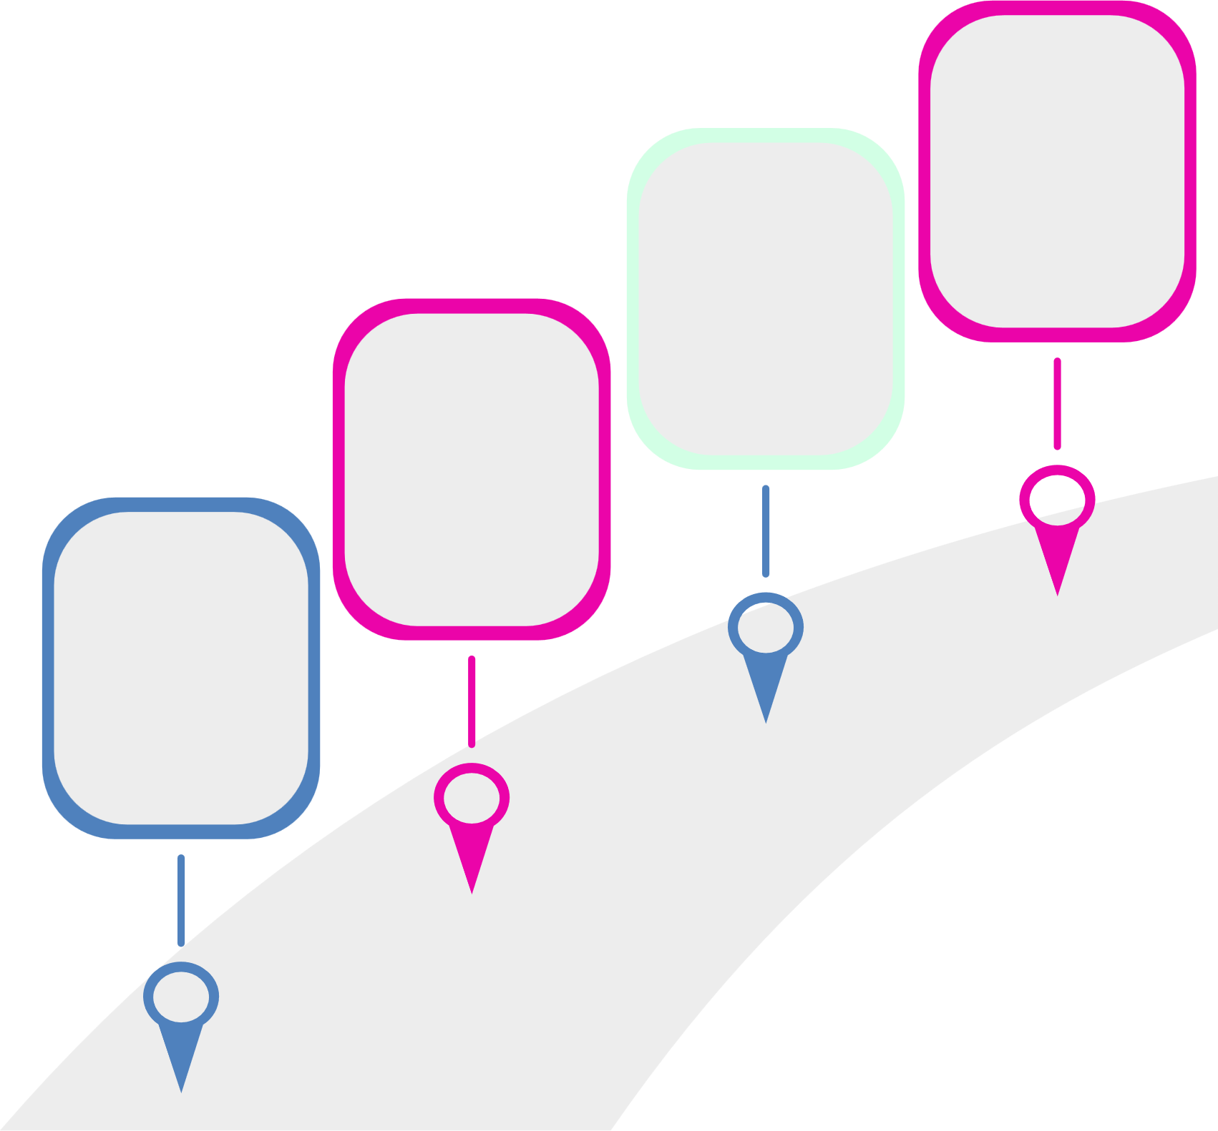

My Journey to Where I am Today Looks Something Like This...
Current
Role
Internship
OR
First Job
College
Reminder to presenters:
Everyone’s journey is unique. Maybe your path wasn’t so straight. Share your journey.
High
School
How long did it take you to get to where you are today?
Did you have an internship?
What was your first job and how did you get it? How quickly did you advance?
Where did you go to school? What was your major?
Did you always know you wanted to go into accounting? What organizations did you join?
What advice do you have?
What classes did you take?
What organizations did you join? What jobs did you have?
Notes:
Update this slide with the information asked above. As the reminder states, everyone’s journey is unique. Share your journey.
If you know where you’d like to see your path go next, share that with the students too!

Slide 13





becoming a
certified public accountant
+
+
+
Education
Experience
Ethics*
Exam
=
CPA
*Certain states require a separate ethics assessment in addition to what is tested on the CPA Exam.
Notes:
And along the way (share your specific story here), I decided I wanted to take my career a step further. To show I'm among the top in my field. So I became a Certified Public Accountant. This means I passed a 4-part exam and met the education and licensure requirements in my state to become a CPA. Just like Doctors and Lawyers have to work a little extra hard, so do CPAs. And just like for Doctors and Lawyers, becoming a CPA means more money too.

Slide 14

do you have what it takes to become a cpa?
Do you like puzzles?
Do you like working in teams?
Do you like technology?
Do you like helping people?
Notes:
So, could accounting be right for you? Do you have what it takes to become a CPA?
Make this part interactive and ask the students to raise their hand for each question they relate to. If this sounds like you, explore accounting!

Slide 15




Could this be the career that sets me up for success?
A career in accounting can offer...
Job stability.
Accountants are always in demand.
Strong earning potential.
A solid career path with room to grow
your income or start your own business.
Career flexibility.
Opportunities exist in every industry,
from sports to tech to entertainment.
Sense of fulfillment.
You’ll play a key role in helping people
and businesses succeed.
Notes:
If you answered yes to any of those things, you might be wondering if accounting could be the career that sets you up for success.
Review what a career in accounting can offer.

Slide 16


Action Steps to start today
High School
College
Status | Task
 | Take an accounting class if your school offers one
 | Join a business club or organization (i.e., DECA, BPA, FBLA)
 | Discuss accounting with a career counselor
 | Ask the adults in your life if they know an accountant you can shadow for a day
 | Visit ThisWayToCPA.com to learn more about careers in accounting
Status | Task
 | Take an accounting class
 | Discuss accounting with a career counselor, academic advisor, or accounting professor
 | Join an accounting club like Beta Alpha Psi
 | Find an accounting internship or a CPA you can shadow for a day
 | Get involved with your local state CPA society
Notes:
I mentioned some things I did when I was in your shoes. Here's a checklist of some things you can do to start exploring accounting: take an accounting class if available, join a business club or organization, discuss accounting with a career counselor and ask the adults in your life if they know an accountant you can shadow for a day. You can also visit ThisWayToCPA.com to learn more about careers in accounting.
When you get to College, continue those accounting classes, join an accounting specific club, and eventually start looking for accounting internships. You can even get involved with your local state CPA society <promote your local state CPA society here>.

Slide 17
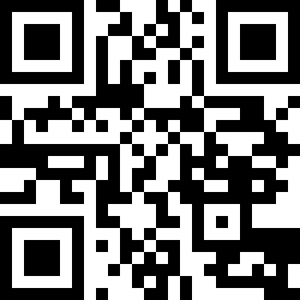


Join the AICPA as a free
Student Member
Hear more about different careers
you can have as a CPA.
Apply for scholarships to help
pay for college.
Build your LinkedIn profile with templates and professional advice.
Receive guidance and tips for landing
your first job.
Notes:
A great way to get started is to join the AICPA as a free student member. The AICPA & CIMA is the most influential global network of management and public accountants, with nearly 600,000 members worldwide. As a member association, they are here to support you throughout your entire journey, providing membership for high school students, college students, CPA exam candidates and licensed CPAs.
As a student member, you receive access to monthly webinars where you can hear from CPAs in other industries; you can apply for scholarships to help you pay for college - the AICPA Foundation awards over $1M in scholarship funds each year to accounting majors; you receive templates and professional advice to build a LinkedIn profile that will have you standing out; and get help landing your first job with guidance and tips from professionals.
You can join via the QR code, or at ThisWayToCPA.com.

Slide 18
State CPA Society
Information
Personalize this slide with programs available for high school students.
Include resources available for high school students.
Be sure to add websites, or QR codes where available.
And add your state CPA society logo in the frame provided.
Notes:
Personalize this page with information about your state CPA society. Include the logo, website and QR codes and information about high school specific programs and resources.
If your organization offers resources for students, add another slide to share more information!

Slide 19









Follow us:
@AICPAstudent
Contact Us:
www.ThisWayToCPA.com
ThisWayToCPA@aicpa.org
Notes:
Be sure to follow @aicpastudent on social media for information on upcoming webinars, scholarship deadlines, and even a little accounting humor.

Slide 20

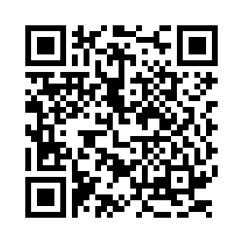

We want to
hear from you!
Notes:
Please first ask the teacher if students are permitted to use their cell phones before asking students to complete the survey.
If not permitted, let the teacher know an email link will be sent to them for students to complete the survey via computer if they’d like.
We’d like to gauge your thoughts on accounting following the presentation and ask that you complete a short survey. The survey is voluntary, only 8 or 9 questions long and will take 1-2 minutes to complete. You just point the camera on your phone to the QR code on the screen and follow the link that comes up.
The following questions are asked:
How did this presentation affect your interest in accounting as a career?
Where do you learn about possible careers?
What is the likelihood that you will pursue accounting as a major?
What is your high school graduation date?
What is the name of the school you are currently attending?
In what City and State is your school located?
What are your plans following high school graduation?
*Optional* If you would like to receive email updates from the AICPA on opportunities in accounting, scholarships, and free student membership, please provide your name and email address.

Slide 21
would you rather...
Optional End of Presentation Activity
Notes:
If time permits, have some fun with a quick “Would You Rather” game. Have students shout out their answers, raise their hands, or (if they look like they need to move), have them get up and move to one side of the room or the other when selecting their answers to the following…

Slide 22

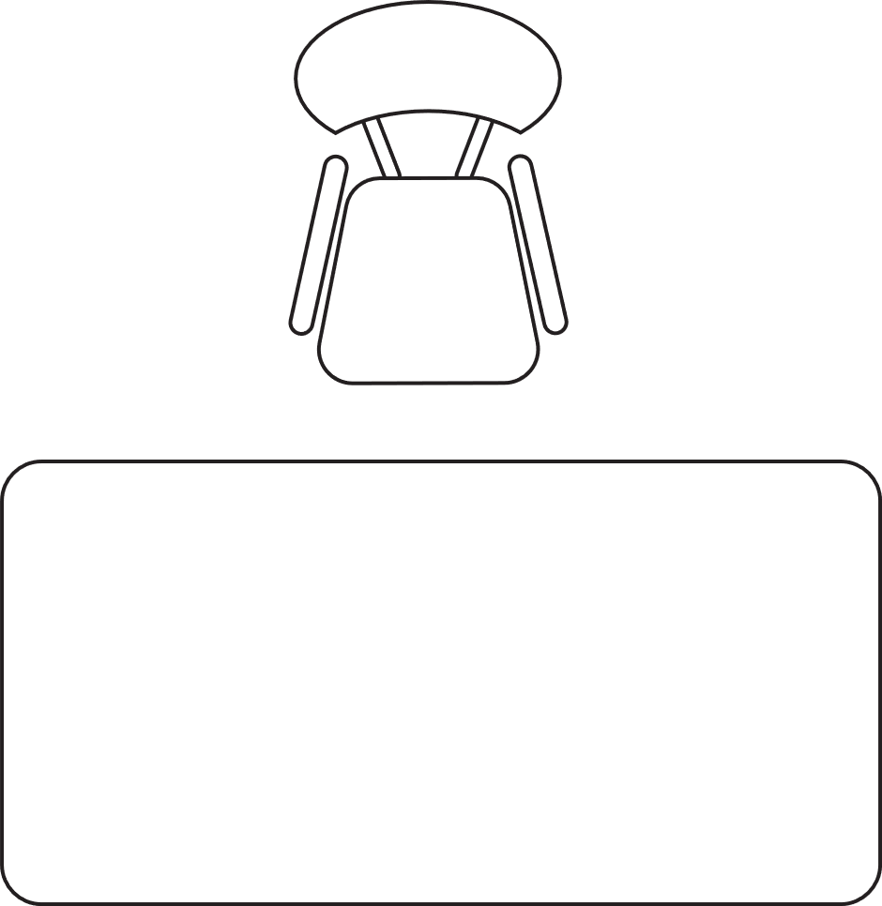


Work in a cube or travel for your job?

Slide 23


Work by yourself or work in a team?

Slide 24


investigate fraud or help save our planet?

Slide 25


track the money or tell a story?

Slide 26


work for a company or own your own business?

Slide 27
in accounting, there’s something for everyone!
Travel for your job
Work at a desk
Work in a team
Work by yourself
Investigate fraud
Protect the environment
Keep track of the money
Use finances to tell a story
Work for a company
Be your own boss
Notes:
No matter your preference, in accounting there is something for everyone!

Slide 28



questions?
Notes:
26

