Slide 1



AN INTRODUCTION TO THE ACCOUNTING PROFESSION

Slide 2




They’re the backbone of the business world
They keep finances in check—for everyone
They help companies thrive in times of uncertainty
They implement new accounting technologies and systems

Slide 3





Accountants work in many different settings,
making their mark in a variety of ways.
Helping directors bring their on-screen visions to life without going over budget
Identifying data trends and making strategic decisions based on findings
Traveling the world managing financial affairs for global companies
Work with law enforcement to catch white-collar criminals and financial wrongdoing
Writing code to automate manual processes and work more collaboratively with technical specialists
Notes:
*Director Photo by Brock DuPont on Unsplash
*White Collar Photo by Taylor Grote on Unsplash
*Trends Photo by Adeolu Eletu on Unsplash
*Code Photo by Mikhail Fesenko on Unsplash
*Travel Photo by Guilherme Stecanella on Unsplash

Slide 4





Looking for a way to give back?
Consider a career in accounting.
Devising ways for companies to become more green and sustainable
Finding ways to keep costs down on services for local low-income families
Being the watchdog who ensures state taxpayers’ money is being spent wisely
Stretching dollars from donors to help charities make the biggest impact possible
Helping clients navigate estate, retirement and philanthropic planning
Notes:
*Sustainable Photo by Appolinary Kalashnikova on Unsplash
*Charities Photo by Joel Muniz on Unsplash
*Families Photo by Luana Azevedo on Unsplash
*Planning Photo by Scott Graham on Unsplash
*Money Photo by Vitaly Taranov on Unsplash

Slide 5


Where
the benefits just
keep stacking up
Demand is high
Earning potential
Job security
Flexibility
Opportunities for advancement
Business ownership
Nearly endless possibilities
Notes:
Demand: There are more positions than skilled accountants to fill them. As organizations are becoming more and more globalized, the need for skilled accountants—especially those with diverse backgrounds and experiences—is only going to continue to grow.
Earning potential: Those who work with money bring home a good amount, too. And those with more experience make far more—we’re talking six, or even seven, figures!
Job security: It’s one of the most recession-proof careers out there. While changes in the economy tend to have a direct impact on many professions, money matters are often even more critical when the market isn’t as hot. This affords many accountants much greater job stability regardless of what’s going on in the world.
Flexibility: Work/life balance is a priority for big accounting firms. According to an article by the New York Times, big accounting firms have done the math and seen that being creating better work/life balance for employees is financially beneficial. Plus, much of the work accountants do can be done from anywhere, which makes managing life and deadlines much easier and helps prevent burnout.
Opportunities: Prove yourself and the sky’s the limit. Accountants hold everything from entry-level jobs to CFO positions and everything in between. Depending on what route you decide to take, promotions can come on a fairly regular basis and offer even more opportunity to focus on the aspects of your job that interest you the most.
Want to own your own business? Be your own boss? Understanding accounting, the ‘language of business’ will help ensure your company is a success!
Possibilities: Accountants do many different things in every industry. Accountants work in every industry under the sun. So whatever you’re into—whether it’s food, photography, football or advising an entrepreneur on their start-up company —there’s a professional who accounts for it. That means if you decide as an accountant that you want to mix things up, there’s always another industry or position that’s ready to welcome you with open arms.

Slide 6

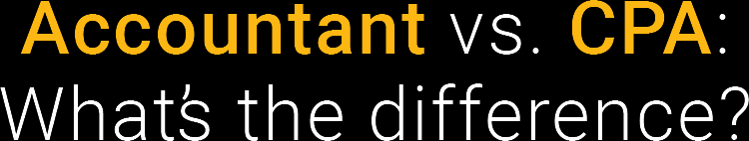
CPAs ARE ACCOUNTANTS WHO:
Are certified –
CPA stands for Certified Public Accountant
Earn more throughout their career than their non-CPA counterparts
Often get more frequent and higher-level promotions
Are able to start their own firm and be their own boss
Garner more respect and trust
Have a competitive edge over non-CPAs
Experience greater
job security
Can become even more specialized
Take on highly valued, consulting roles
Notes:
A CPA is a trusted advisor to individuals, businesses, and other organizations, helping each achieve their financial dreams and goals. Whether advising businesses on multi-million-dollar acquisitions, auditing companies’ 401K plans, or helping people investment for retirement, a CPA’s adherence to a strict code of ethics along with accounting and finance expertise allows the public to put their trust in CPAs.
For more detailed information see pg. 8 of the printed Primer to the Accounting Profession piece.

Slide 7


What do you need to become a CPA?
+
+
+
=
Education
Experience
Ethics*
Exam
CPA
* Certain states require a separate ethics assessment in addition to what is tested on the CPA Exam.
Notes:
So what does it take to be a CPA? Here are the requirements. (this can be found in the state requirements section of ThisWayToCPA.com)
The 4 E’s:
Experience (1-2 years in most states)
Education (150 hours)
Examination (passing 4 sections)
Ethics (some states do not require this)
*Note for presenters: Students viewing this presentation will be taking the new CPA Exam following CPA Evolution (https://evolutionofcpa.org/)

Slide 8


“I’M REALLY GRATEFUL FOR THE OPPORTUNITY TO USE MY
CPA LICENSE TO HELP OTHERS.”
–Belicia Cespedes, CPA
“I ENJOY THE CHALLENGE AND THE FACT THAT I CAN DO SOMETHING DIFFERENT EVERY DAY.”
–Tim Cowley, CPA
“BEING IN PUBLIC ACCOUNTING GAVE ME A LOT OF OPPORTUNITIES FOR INTERNATIONAL TRAVEL.”
–Jennifer de Leon, CPA
Notes:
Fun fact: Belicia Cespedes is the youngest CPA ever licensed, at 17 years old!

Slide 9

Chief Financial Officer
Business Owner
Controller
What jobs can you have as a CPA?
Auditor
Forensic Accountant
Tax Accountant
Financial Planning and Analysis Director
Educator
Notes:
Thinking of starting your own company? Accountants have the financial know-how to become successful Business Owners in any industry they choose.
Controllers oversee the accounting department, implement controls and internal audits across the entire company, as well as ensure financial plans align with organizational goals.
Tax accountants handle tax reporting, keep up with changes in tax law, identify areas for tax savings and advise their accounting firm’s clients on the tax implications of their proposed corporate strategies.
Financial planning and analysis directors oversee financial analysts, those who analyze financial data to facilitate strategic decision making. Financial planning and analysis directors focus on the future: budgets and forecasts, which are based on historical analysis and some assumptions about the future of areas such as the economy, industry, clients, production, etc.
CFOs are the head of financial operations for an organization. They are responsible for its strategic direction, risk management and developing and monitoring control systems tied to assets.
Auditors provide an independent and objective assessment of how a company operates—ensuring employees follow procedures and their organization complies with laws and regulations.
Forensic accountants investigate, audit and analyze financial records and accounts for evidence of fraud. They often provide expert testimony, present evidence and relay their conclusions in court.
Educators With your knowledge as a CPA, you can help develop the next generation of CPAs by teaching college classes part-time or full-time.

Slide 10

The world needs skilled accountants.
And they’re willing to pay to get them.
Newly licensed CPAs make up to $93,500 per year. Those with more experience make far more –
upward of six figures annually!
Notes:
Source for all salary: Robert Half, 2021 Accounting & Finance Salary Guide

Slide 11



Accounting isn’t math. It’s money.
People skills are important, too – even more so the further a CPA climbs the corporate ladder.
Notes:
People often believe they need to be a math whiz to become a CPA. The truth is, only the basic math skills are needed. Spreadsheets and computers do most of the number crunching.

Slide 12

Traits of successful CPAs:
CURIOUS
ORGANIZED
CREATIVE PROBLEM SOLVERS
RELATIONSHIP BUILDERS
LEADERS
CRITICAL THINKERS
BIG-PICTURE THINKERS
COLLABORATORS
DECISION MAKERS
INNOVATORS

Slide 13
CPAs are leaders in technology.
Today’s CPAs are more immersed in technology than ever before, which is why tech savviness is now a required skill for the job.
CPAs use their tech skills for things like:
DATA ANALYTICS
DATA VISUALIZATION
ROBOTIC PROCESS AUTOMATION
ARTIFICIAL INTELLIGENCE
CYBERSECURITY
BLOCKCHAIN
Notes:
For more detailed information see pg. 8 of the printed Primer to the Accounting Profession piece.

Slide 14





Slide 15
More about me and
my professional goals.
<<name>> · <<major>>
<<year (eg. Sophomore)>> at <<university/college name>>
I’m a(n) <<affiliation>>
That means I get:
  A stronger resume
  Money for college
  Opportunities to gain
  real-world skills
Around 100 AICPA Legacy Scholarships—worth up to $10,000—are available for different types of students who plan on becoming CPAs.
Learn more and apply online at ThisWayToCPA.com/scholarships
Notes:
**Use this slide if you are a college student presenting to high school students or undecided college students.**
Personalize as needed. Examples below
I’m a(n)… Beta Alpha Psi member, AICPA Legacy Scholar, AICPA Student Affiliate Member (Not a member? Join today at ThisWayToCPA.com/join)
Presenter Notes:
Answer the questions on the slide—Feel free to change these if you have other ideas on what to share
Describe your college experience so far (e.g., what your classes are like, organizations you have joined and why you decided to major in accounting, what they can do now to starting preparing for an accounting major)
Tell students about your career goals
Ask for and answer questions from students
Reminder: AICPA student affiliate membership is free and awards around 100 Legacy Scholarships each year!

Slide 16
More about me and my work
in the accounting profession.
<<name>> <<title>>
<<company>>
Number of years as a CPA: <<your answer>>
Why I went into accounting: <<your answer>>
Favorite part of being an accountant: <<your answer>>
My best advice: <<your advice to future accountants/CPAs>>
Notes:
**Use this slide if you are a CPA, state society representative or accounting faculty presenting to high school students or undecided college students. Personalize as needed.**
Answer the questions on the slide—Feel free to change these if you have other idea on what to share
Describe the course of your career so far and how you got into the role you’re currently in
Tell students about your current job and what you like about it
Ask for and answer questions from students

Slide 17

If so, here are some great ways to learn more,
gain experience and get involved:
  Take an accounting class
  Join an accounting club or society (e.g., Beta Alpha Psi)
  Discuss it with a career counselor or academic advisor
  Find an accounting internship or a CPA that you can shadow for a day
  Get involved with your local state CPA society

Slide 18
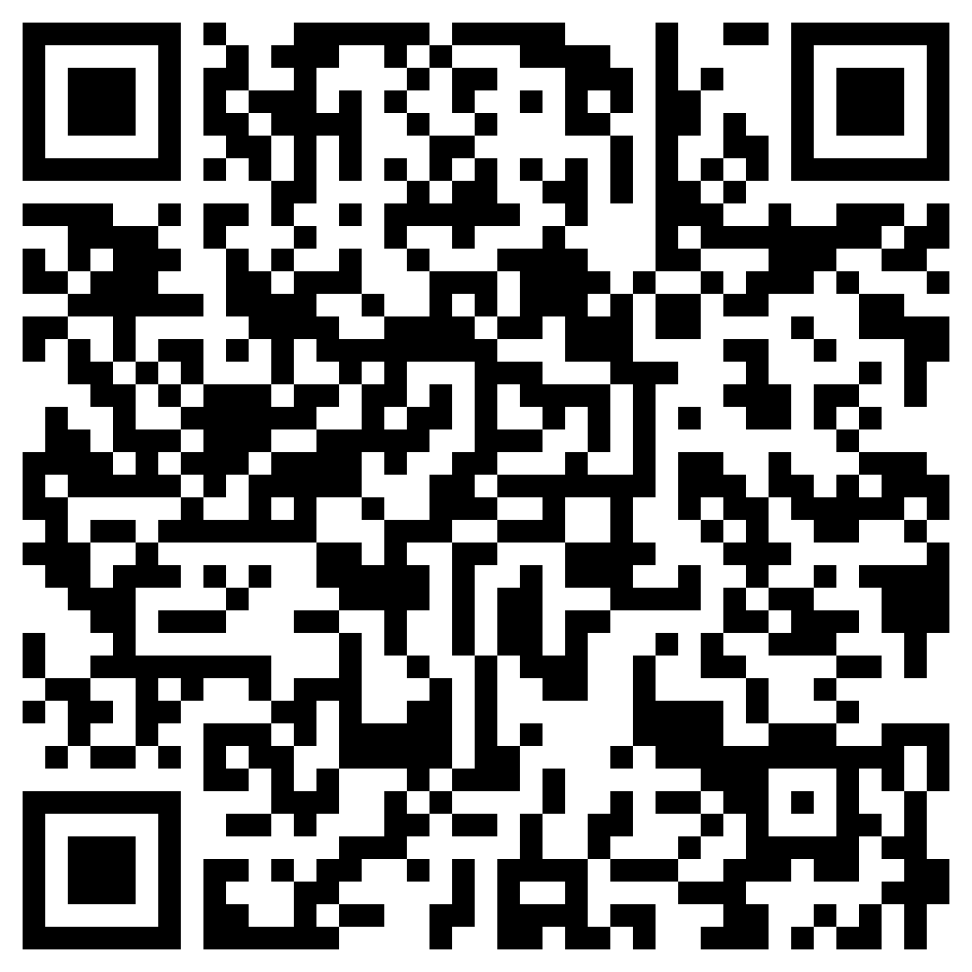
Become an
AICPA Student Affiliate Member
When you join *the* professional home for CPAs for free, you’ll get:
    Exclusive scholarship opportunities
    Access to upcoming and archived student webinars
    Valuable industry news and publications
    The latest CPA Exam info, directly from the source
    Member-only deals on products and services
    Follow the QR code to join the AICPA:

